Slide 1



SOMEBIZZARE TAIWANESE CUSINE
YOU SHOULD TRY!

Slide 2



1
2
3
4
5
6

Slide 3



Vegetarian
Ovo- vegetarian
Carnivore (with pork!)

Slide 4
1
Asparagus juice
蘆筍汁 lú sǔn zhī

Slide 5
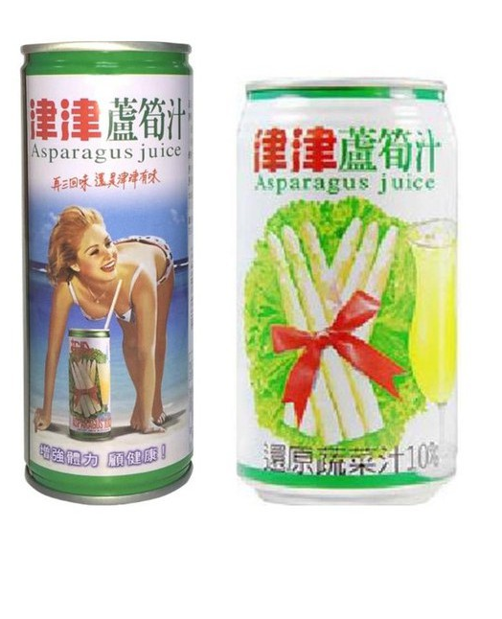
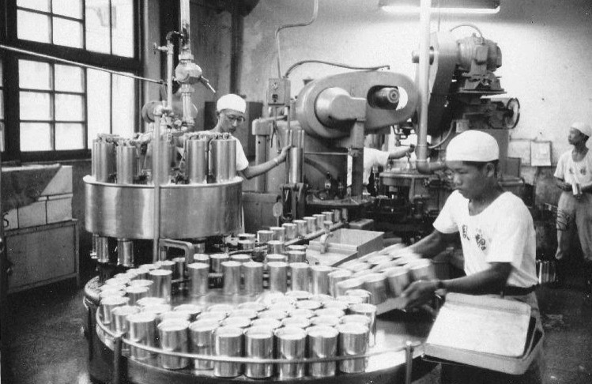
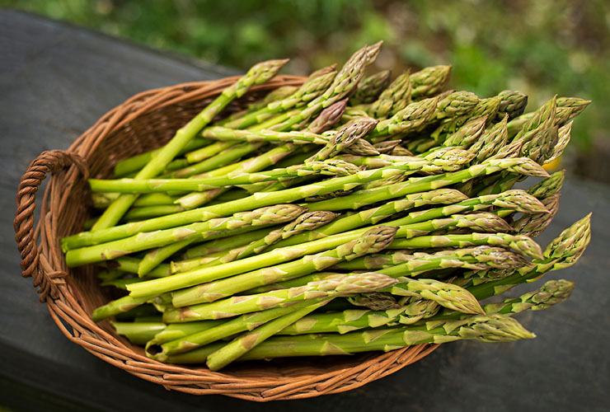
Asparagus juice
蘆筍汁 lú sǔn zhī
shorturl.at/VWZ15
The 1970s :
Top 1 in the production of asparagus can
ā pó
The leftover was used for producing asparagus juice
shorturl.at/hkwV6
shorturl.at/ikno6

Slide 6
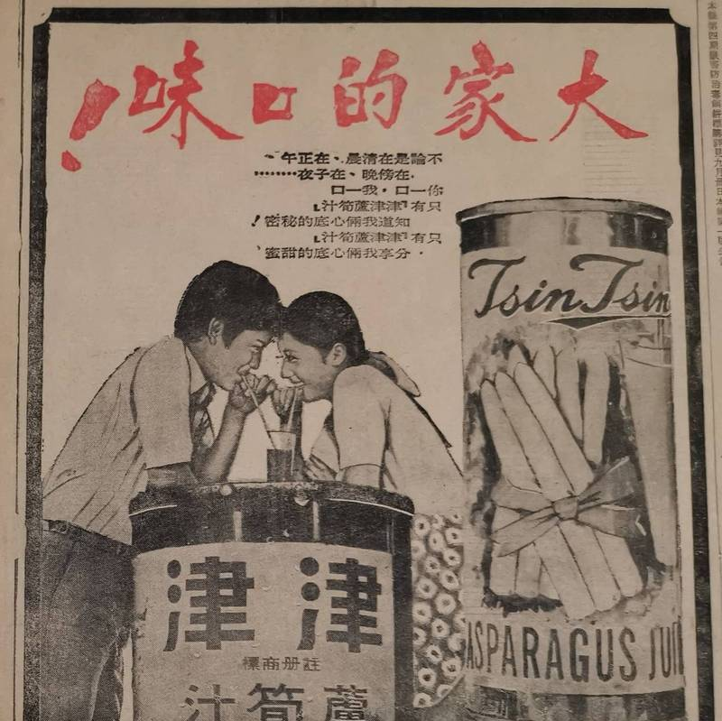
Asparagus juice
蘆筍汁 lú sǔn zhī
One of the most popular drinks before
shorturl.at/FGO78
Where you can find:
Convenience stores, supermarkets, some vending machines
shorturl.at/hkwV6

Slide 7
2
Iron
egg
鐵蛋 tiě dàn

Slide 8
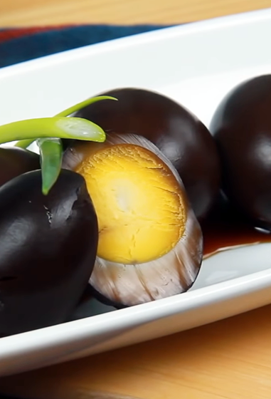
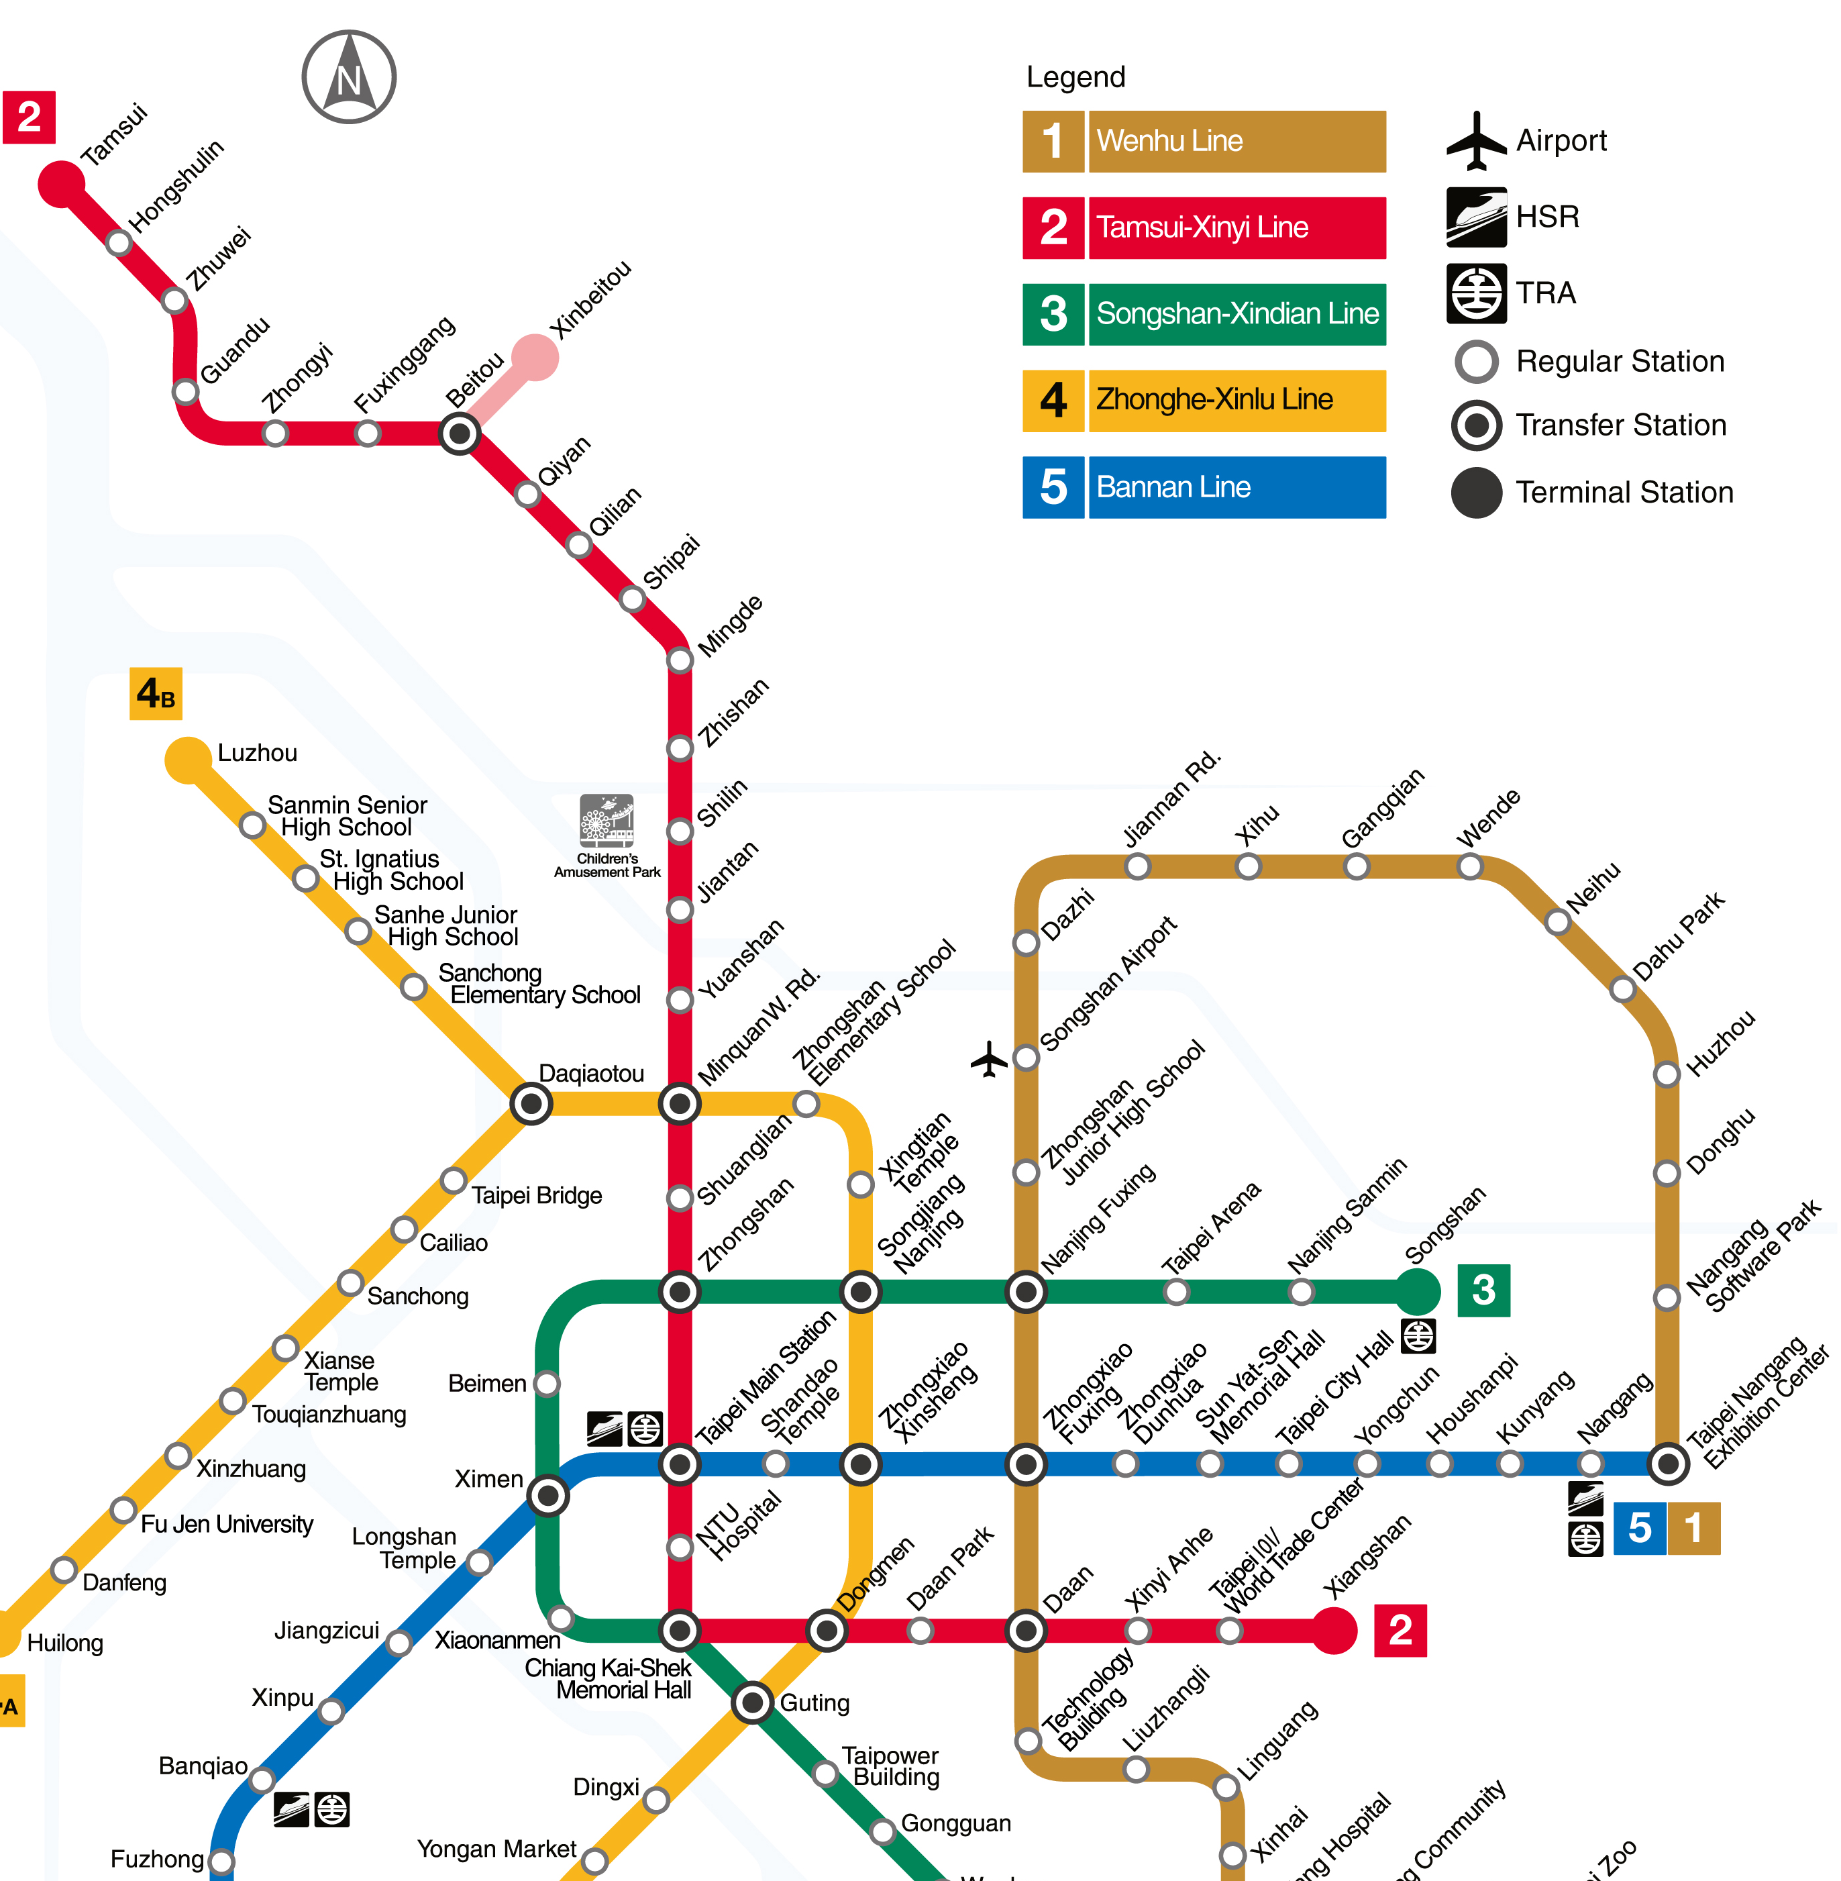
Iron egg
鐵蛋 tiě dàn
Tamsui
Gongguan
Origin: Tamsui (New Taipei City)
shorturl.at/aBLV5

Slide 9





Iron egg
鐵蛋 tiě dàn
阿婆鐵蛋
ā pó tiě dàn
shorturl.at/aBLV5
Notes:
https://en.wikipedia.org/wiki/Iron_egg

Slide 10


Iron egg
鐵蛋 tiě dàn
Where you can find:
Convenience stores and supermarkets
阿婆鐵蛋
ā pó tiě dàn
shorturl.at/aBLV5
Notes:
https://en.wikipedia.org/wiki/Iron_egg

Slide 11
3
Pig intestines in herbal soup
四神湯 sì shén tāng

Slide 12
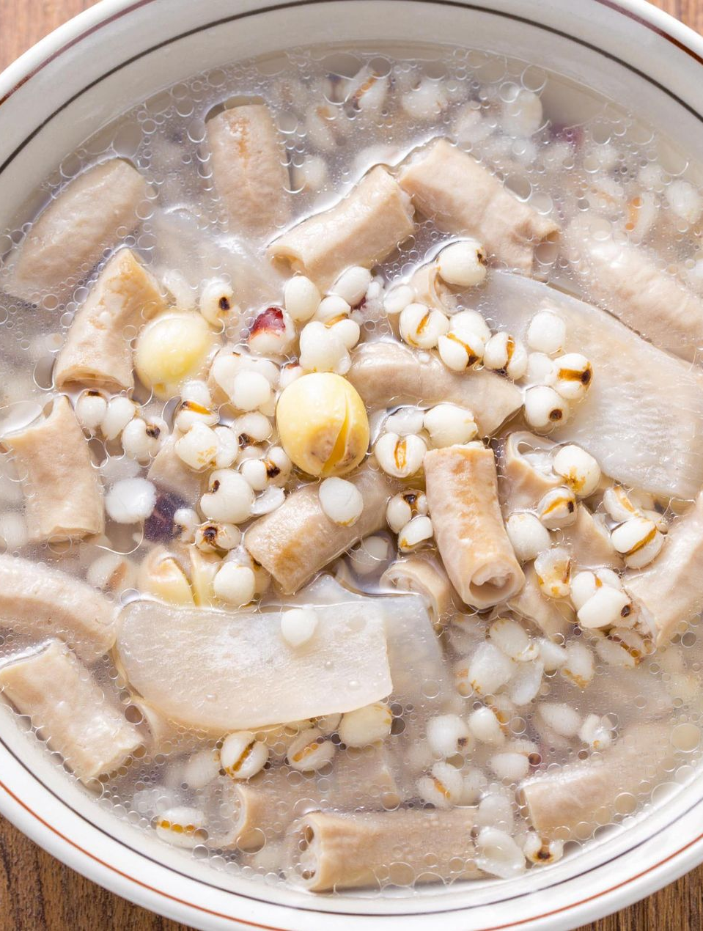
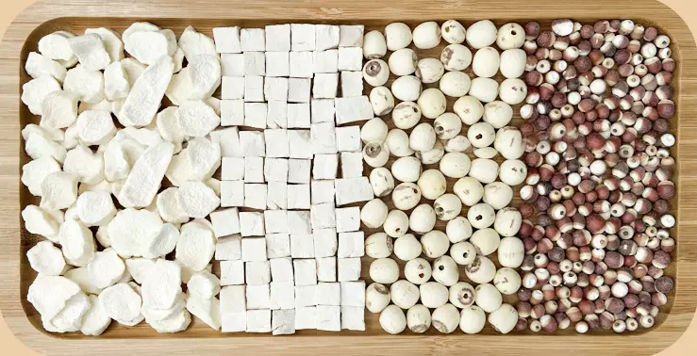
Pig intestines in herbal soup
四神湯 sì shén tāng
Job’s tear
Chinese yam
Lotus seed
Dioscorea polystachya
Euryale ferox
Poria
Pig small intestines
shorturl.at/diJWZ

Slide 13



Pig intestines in herbal soup
四神湯 sì shén tāng
Efficacy
Where you can find:
In some night markets
shorturl.at/aBLV5

Slide 14
4
Pig blood cake
豬血糕 zhū xiě gāo

Slide 15
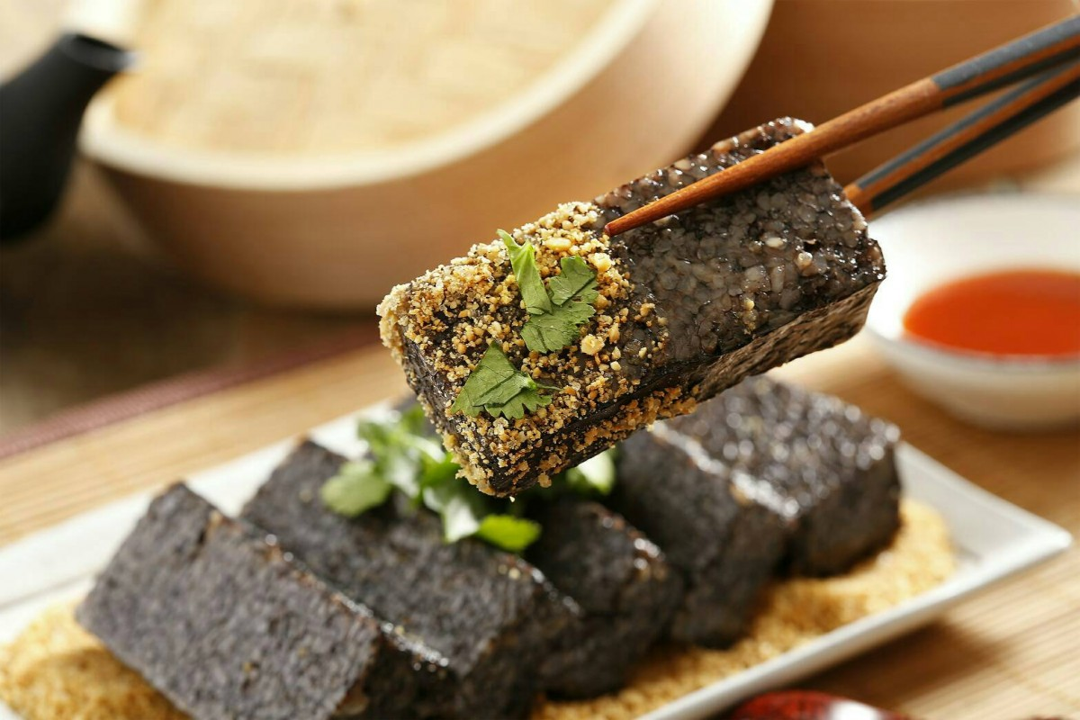
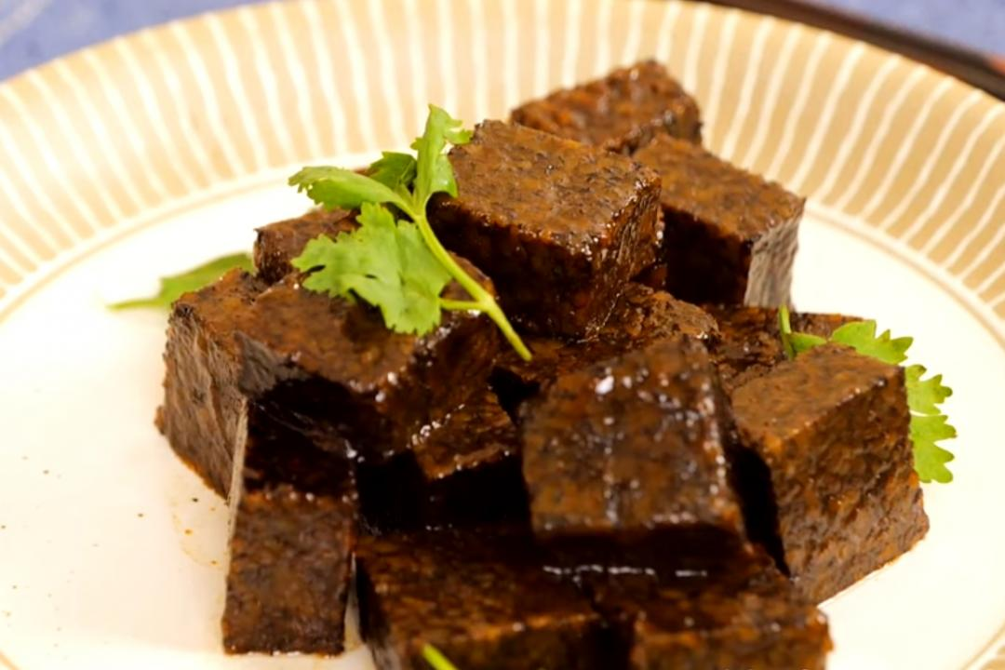
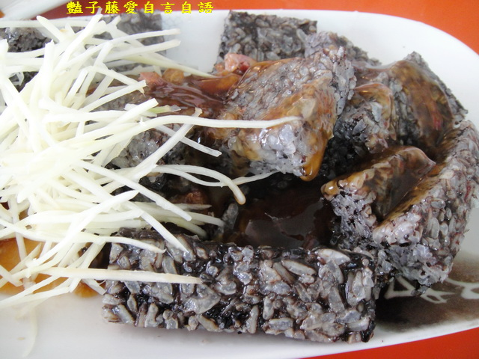
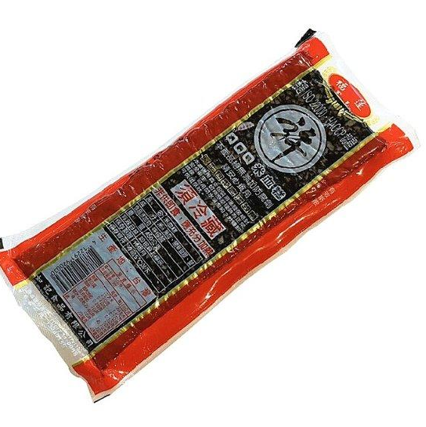
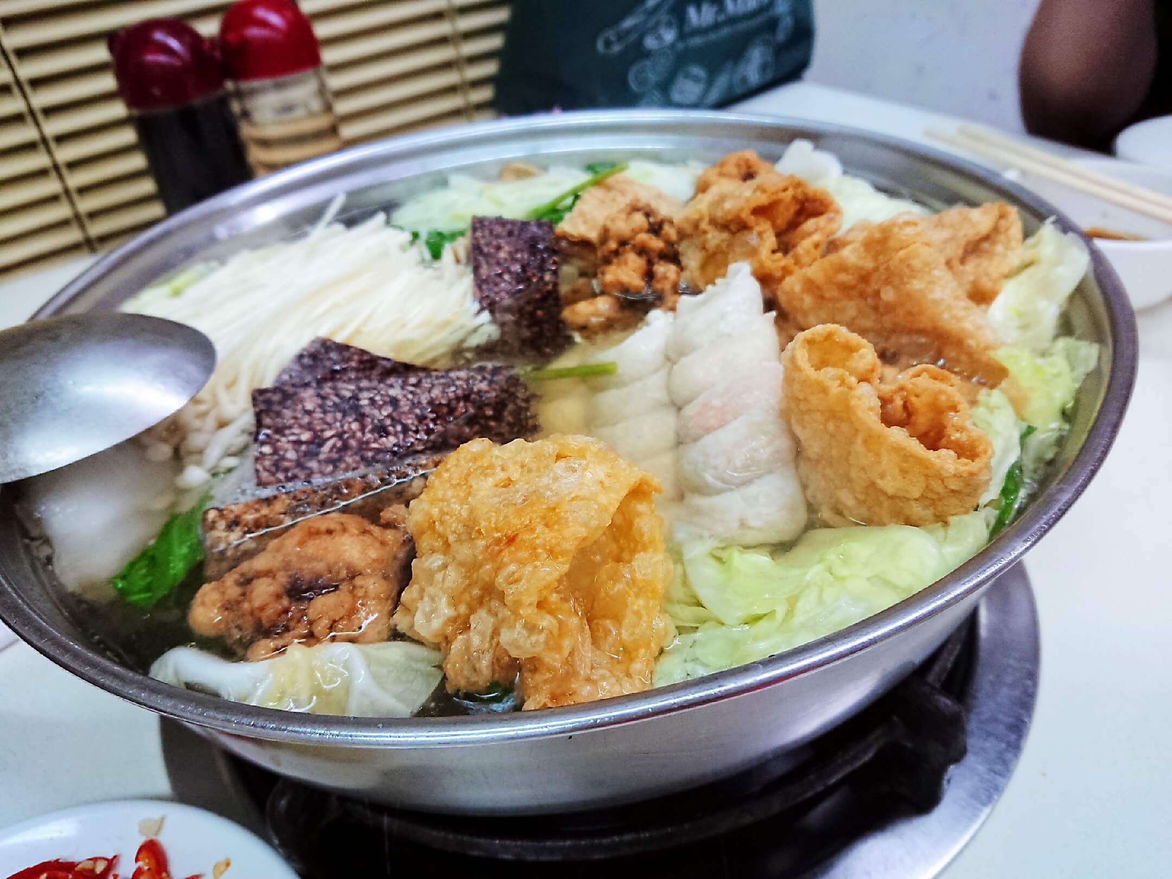
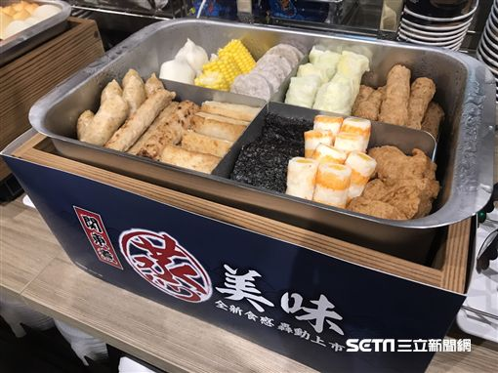
Pig blood cake
豬血糕 zhū xiě gāo
Coriander
Shredded ginger
Soy sauce
Braised
Where you also can find:
Sticky rice and pig blood
Crushed peanuts
shorturl.at/nDFJS

Slide 16
5
Century egg
皮蛋 pí dàn

Slide 17
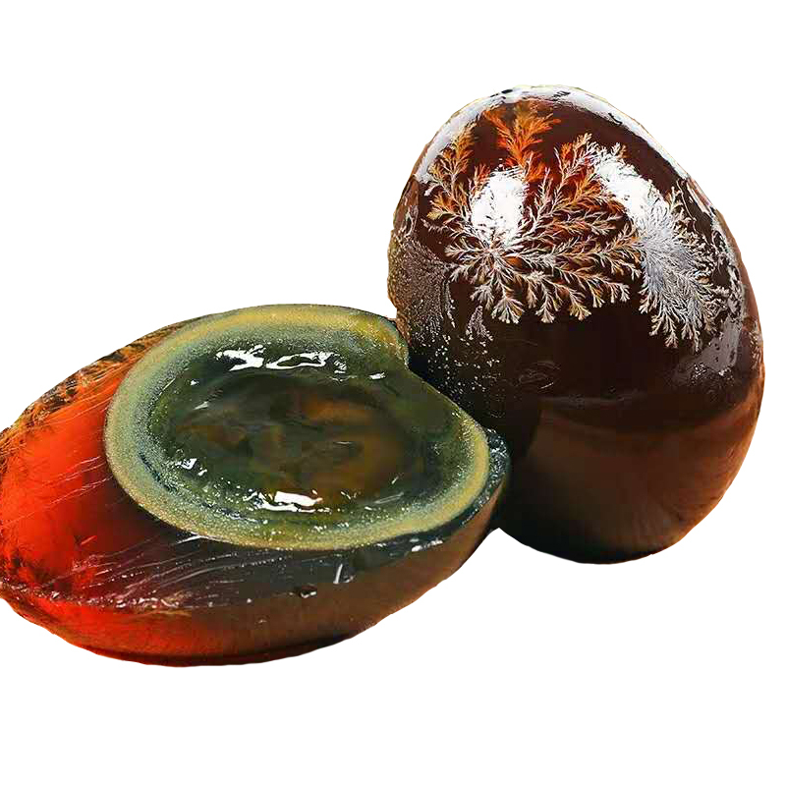

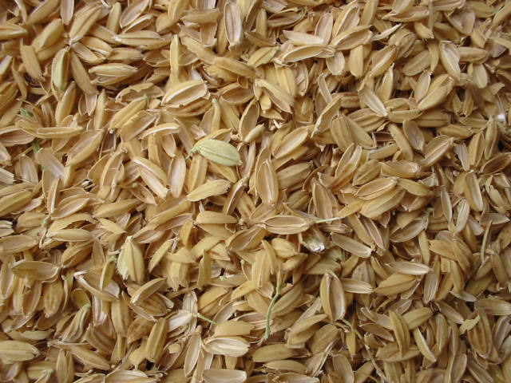
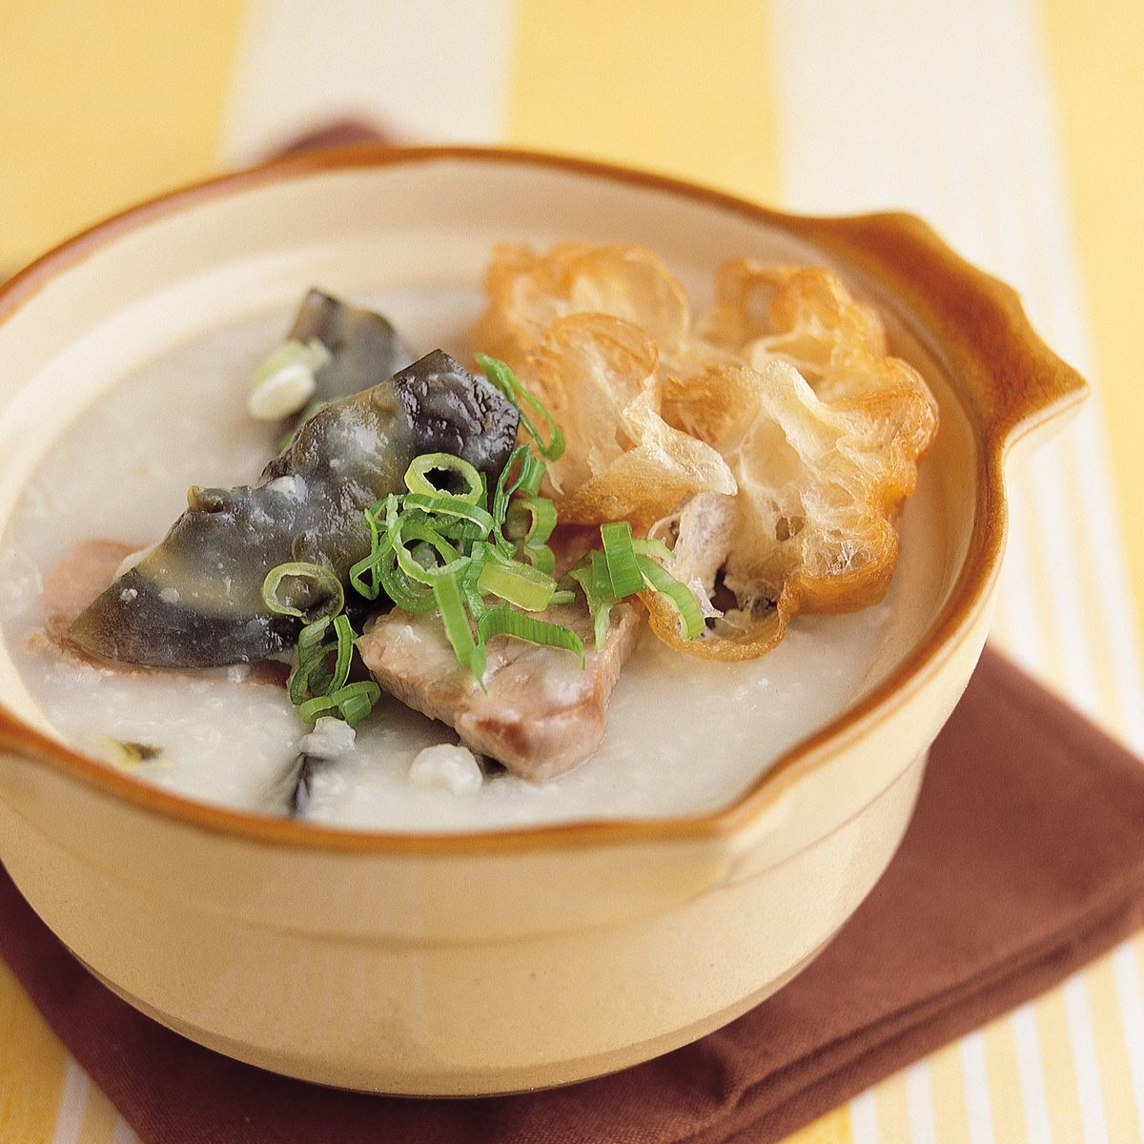
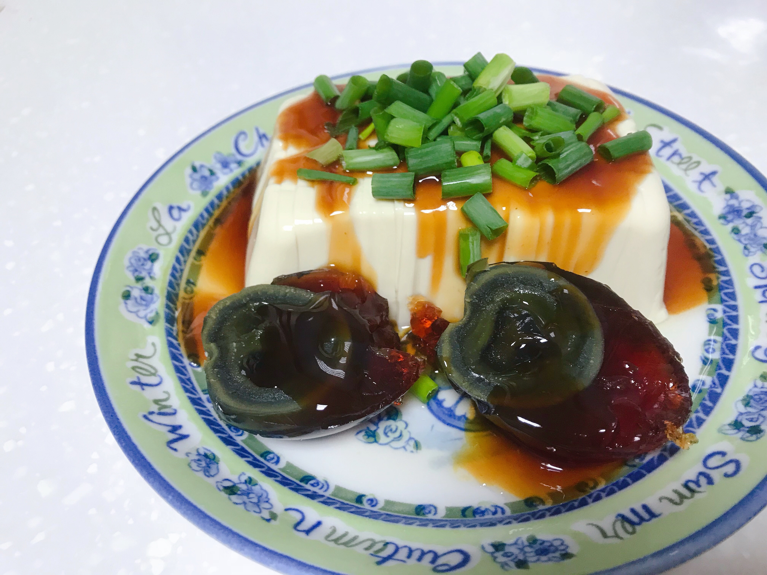
Century egg
皮蛋 pí dàn
Crystal of salt
Egg yolk
Duck egg
Clay & ash
Salt
Quicklime (CaO)
Rice hull
Egg white
shorturl.at/gxCFK
With congee
With tofu

Slide 18
6
Stinky
tofu
臭豆腐 chòu dòu fǔ
Notes:
https://en.wikipedia.org/wiki/Century_egg

Slide 19
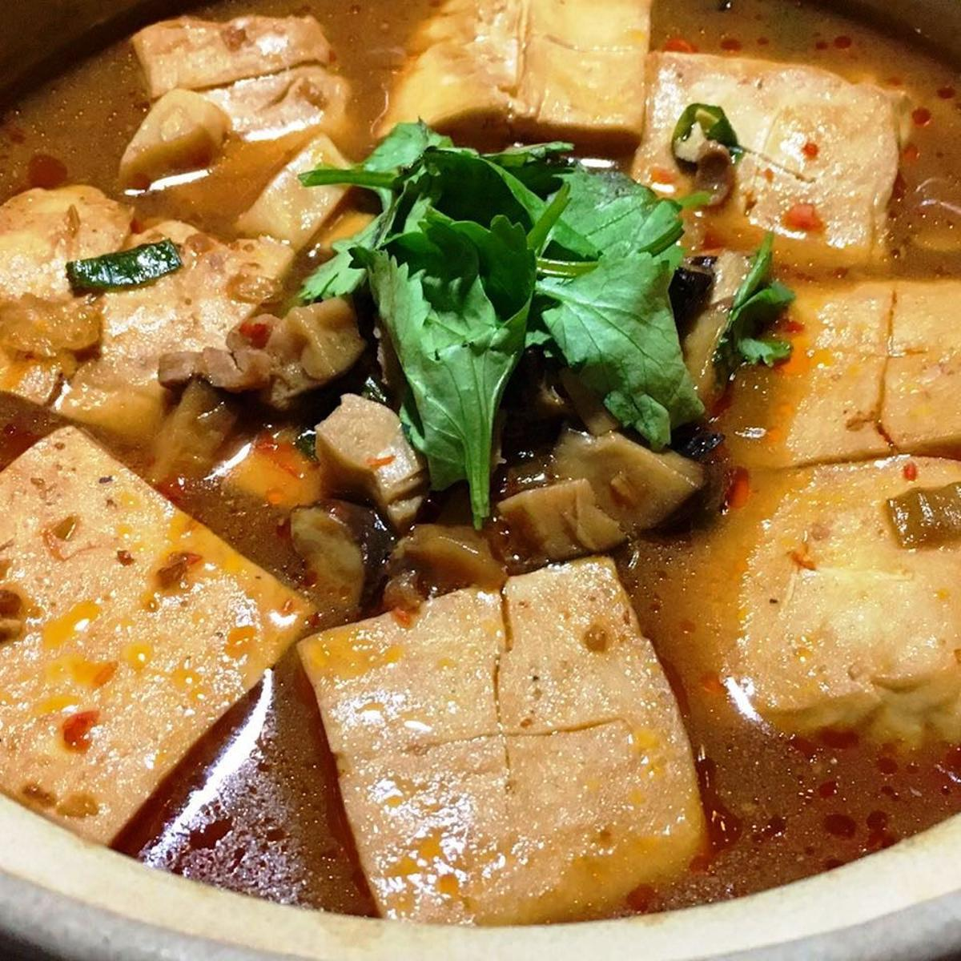




Stinky tofu
臭豆腐 chòu dòu fǔ
Brine
Fermentation for several month
shorturl.at/ruT57

Slide 20
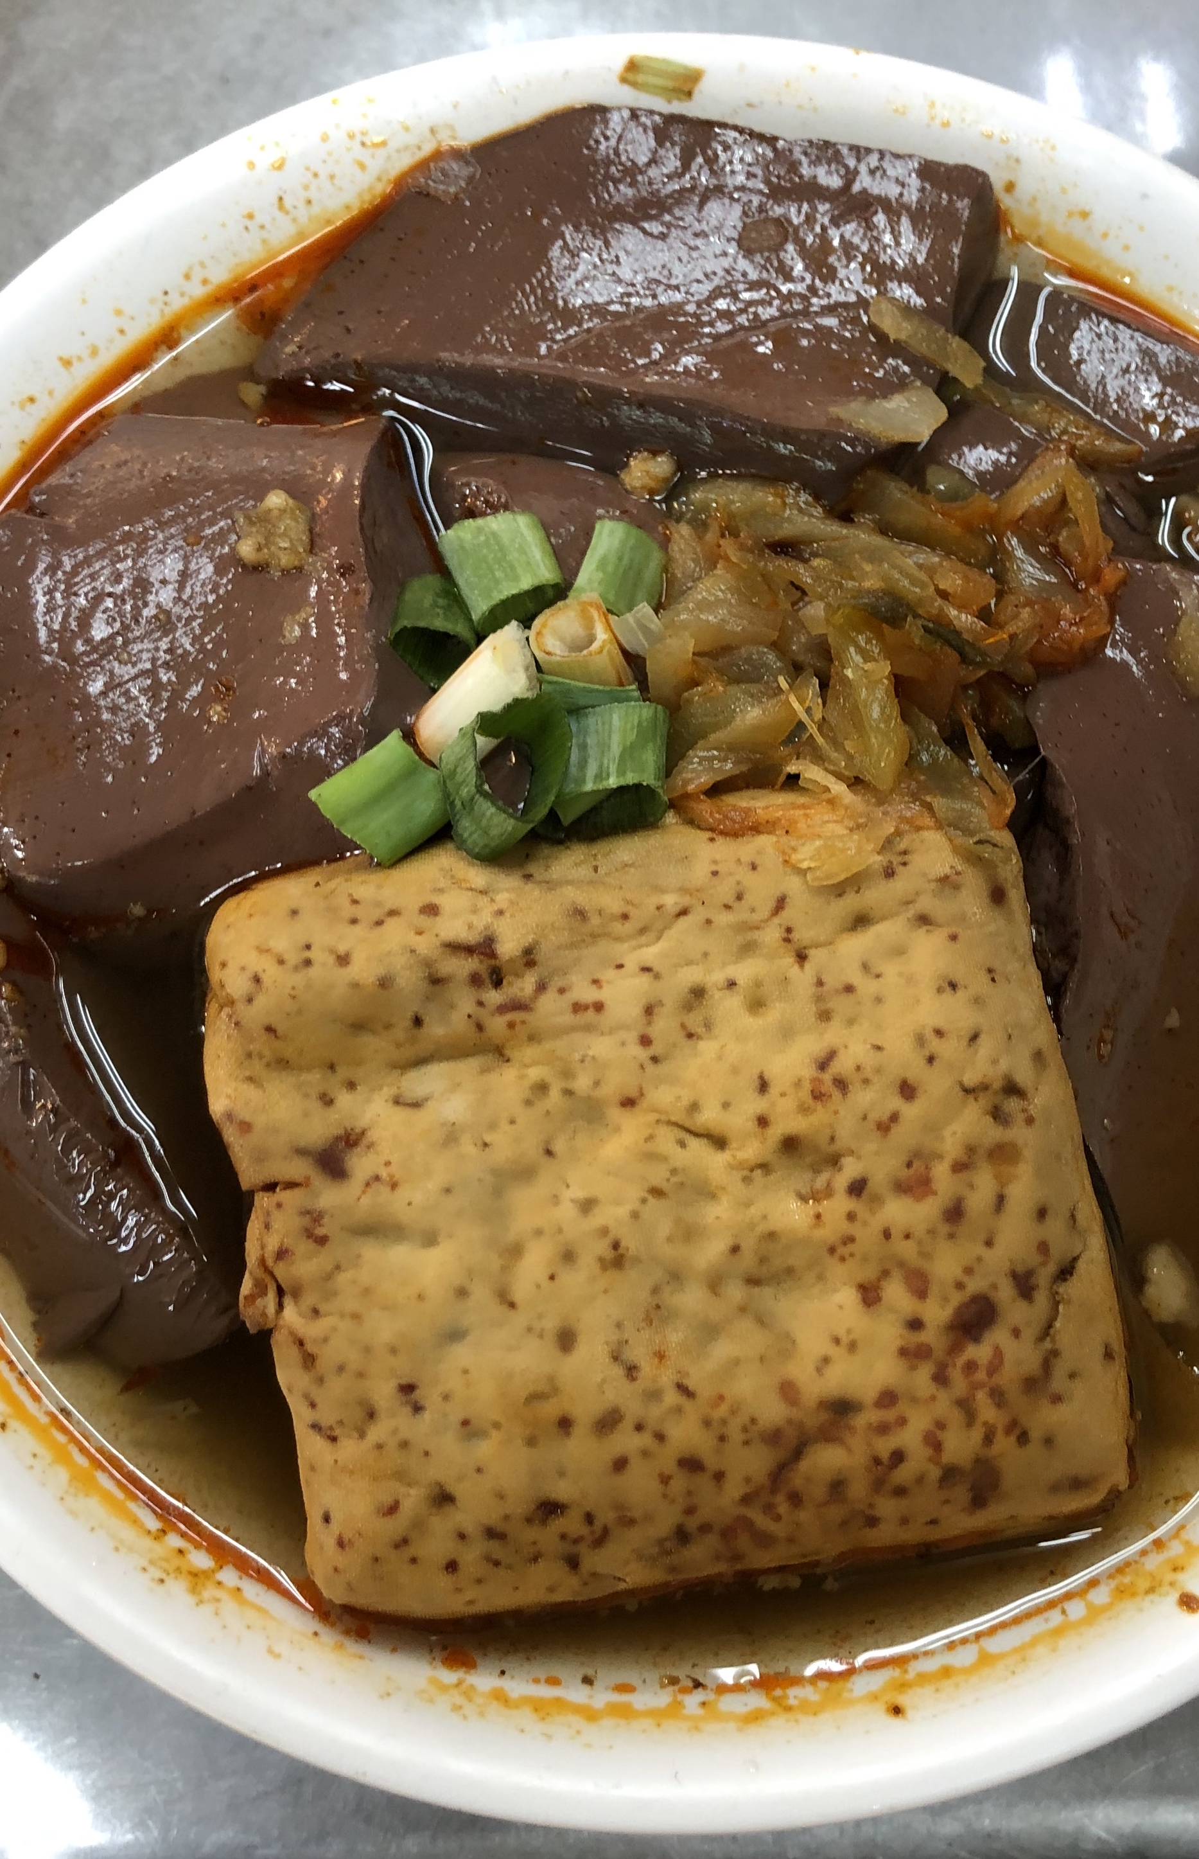
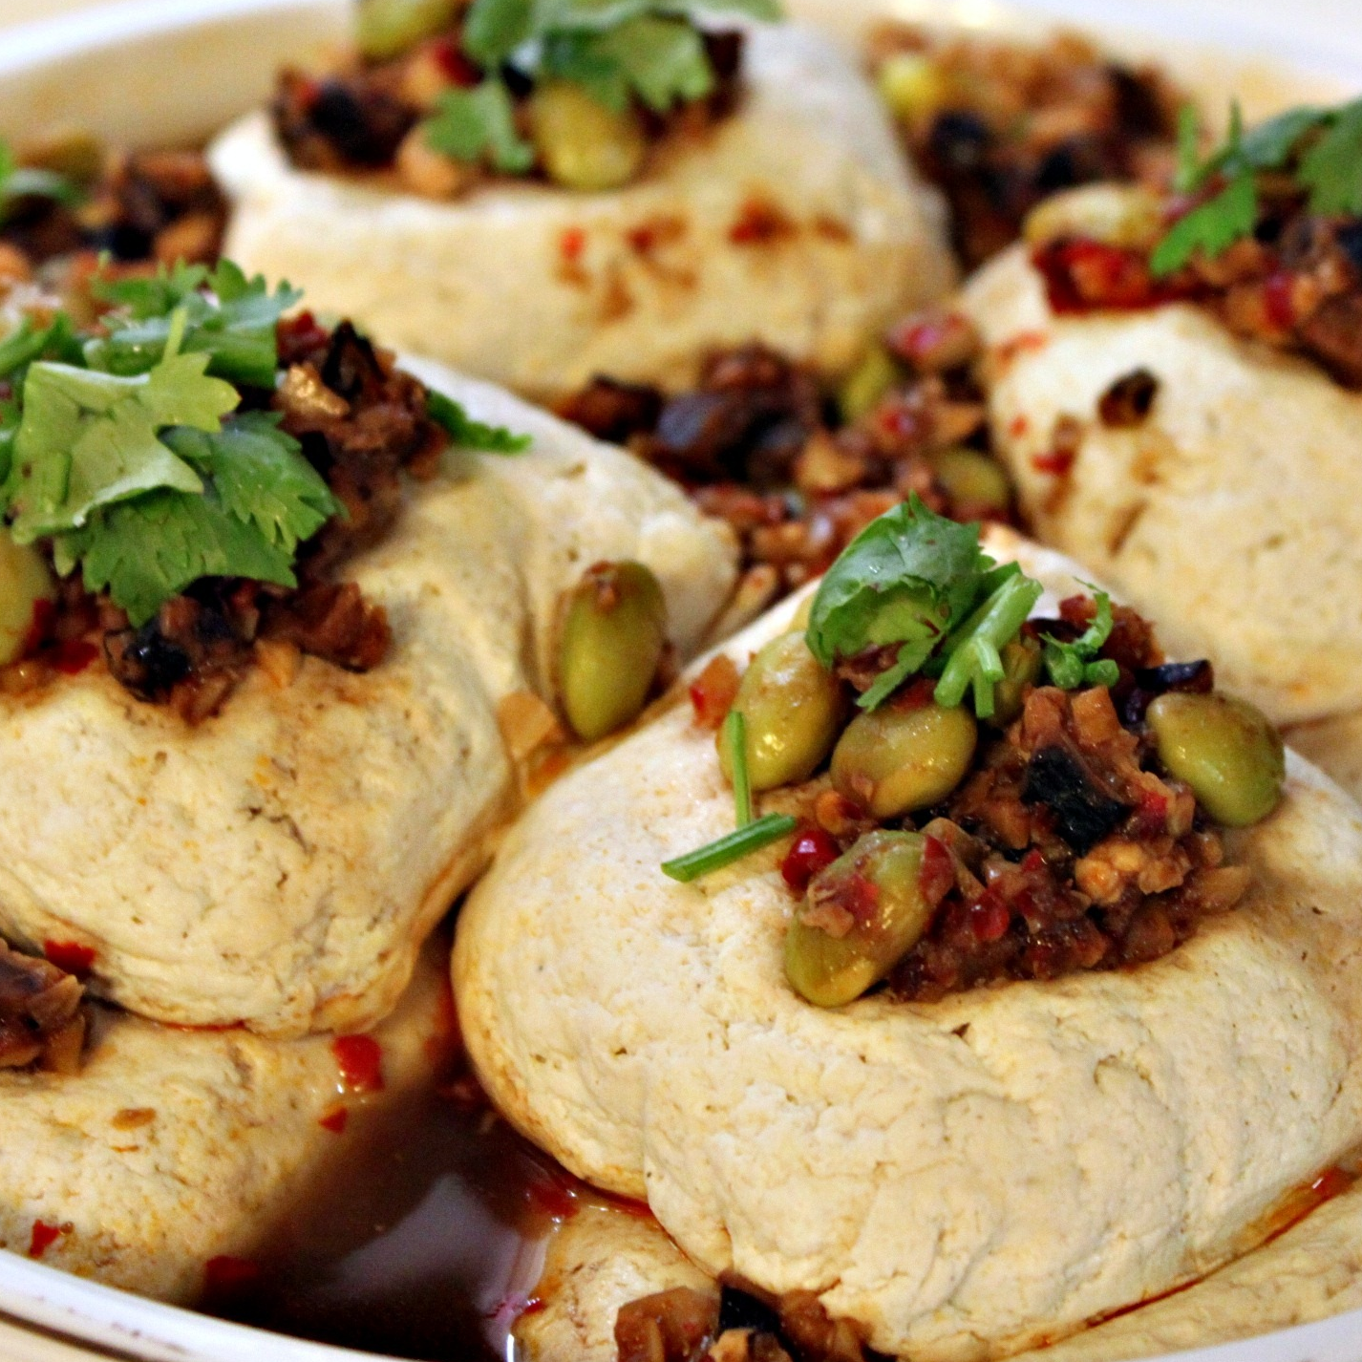
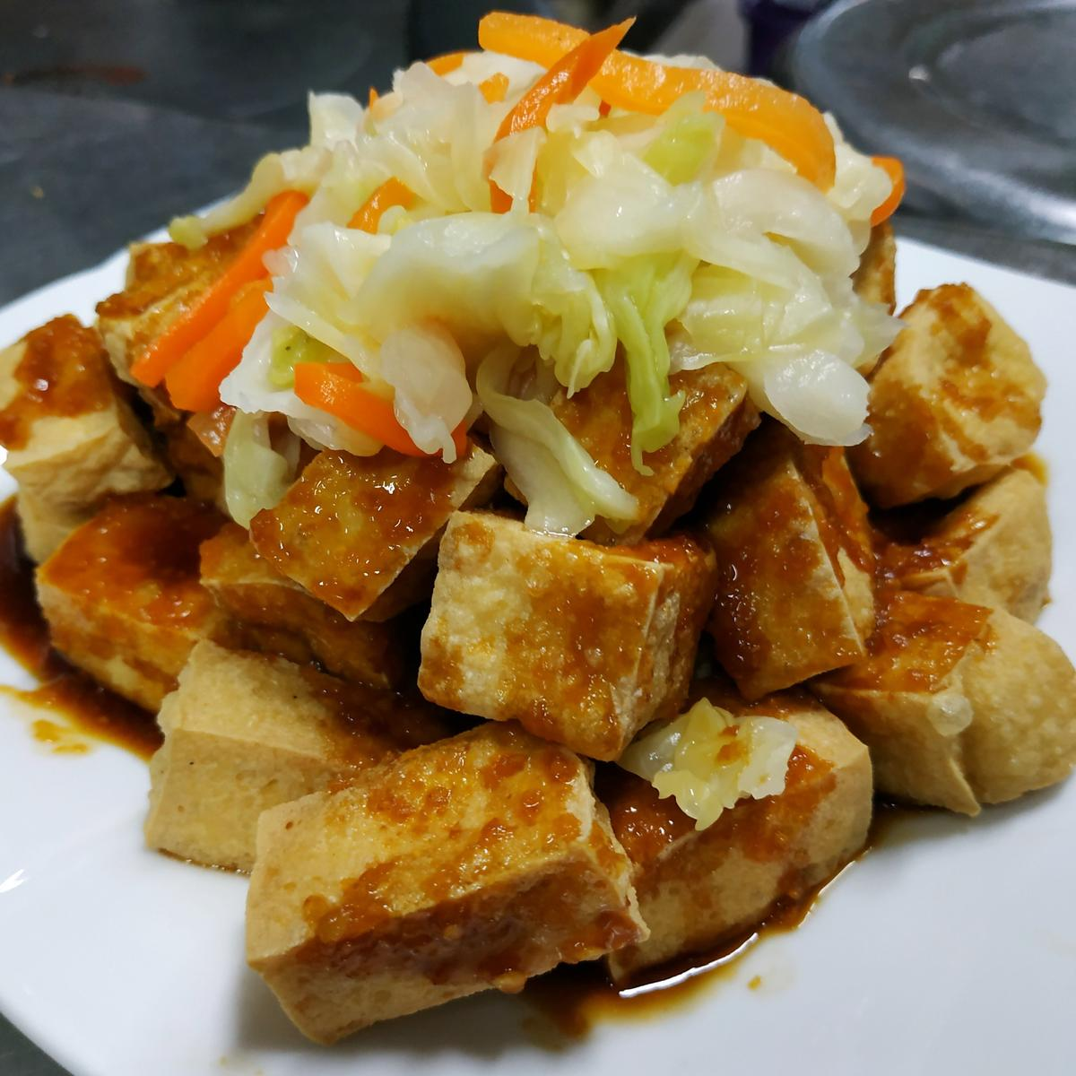



Stinky tofu
臭豆腐 chòu dòu fǔ
Steamed
Fried
Stewed
shorturl.at/exyOP

Slide 21
Thanks for your
COURAGE!!!

